Slide 1
portfolio Presentation
KOUSSOUR Younes

Slide 2
CONTENTS
Features of the system
Technologies used
Video Demonstration
Contacts

Slide 3
INTRODUCTION
Personal Portfolio Web Application
Welcome to my personal portfolio web application! This project showcases my skills, experiences, and projects in a sleek and interactive manner. Whether you're a potential employer, colleague, or just curious about my work, I hope you find this portfolio informative and engaging.

Slide 4
Features of the system
Home Page: A visually appealing landing page that introduces you and provides an overview of your portfolio.
About Me: A section where you can share information about yourself, your background, skills, and interests.
Portfolio Projects: Highlight your past projects with descriptions, screenshots, and links to live demos or GitHub repositories. Organize them by category or technology stack to make it easier for visitors to navigate.
Resume/CV: Provide a downloadable version of your resume or CV for visitors to review your work experience, education, and certifications.
Contact Form: Make it easy for potential clients or employers to get in touch with you by including a contact form or email address.
Social Media Integration: Include links to your professional social media profiles (e.g., LinkedIn, GitHub) to encourage networking and connections.
Responsive Design: Ensure your portfolio is mobile-friendly and looks great on devices of all sizes.
Version Control: Use version control systems like Git to manage and track changes to your portfolio codebase.

Slide 5

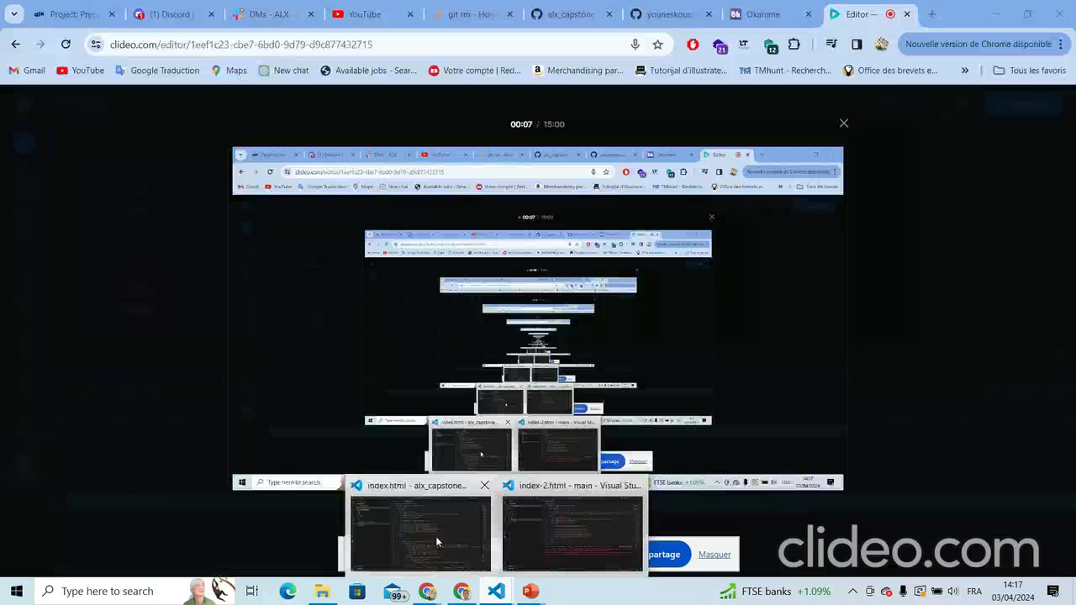
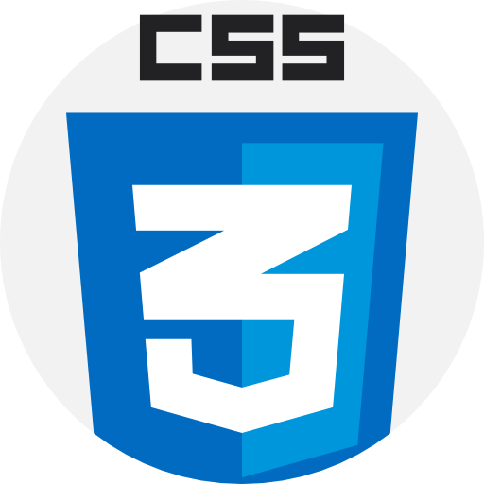

TECHNOLOGIES USED
VIDEO DEMO

Slide 6




CONTACTS
You can reach me on:
LinkedIn
GitHub
Twitter
Mail
Younes koussour
Younes Koussour
Younes Koussour
Younesksr99@gmail.com

Slide 7
THANK YOU
KOUSSOUR Younes
Student at ALX MOROCCO
Software Engineering

